Slide 1
Career Guidance for Intermediate and Secondary Education in Pakistan

Slide 2
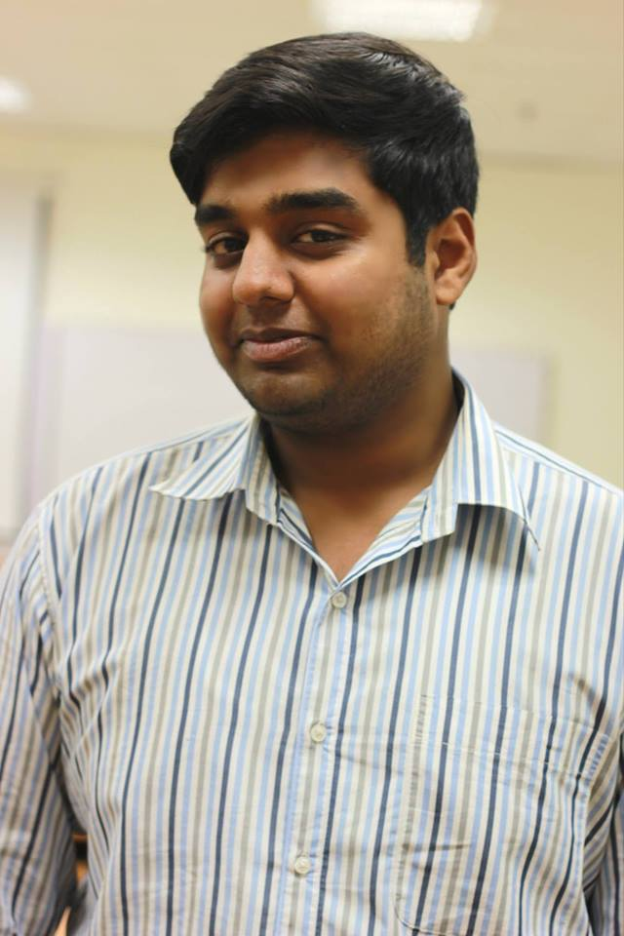
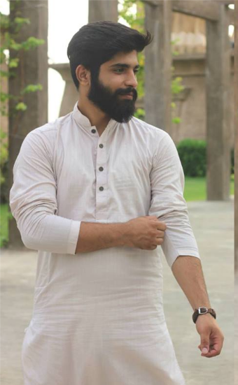
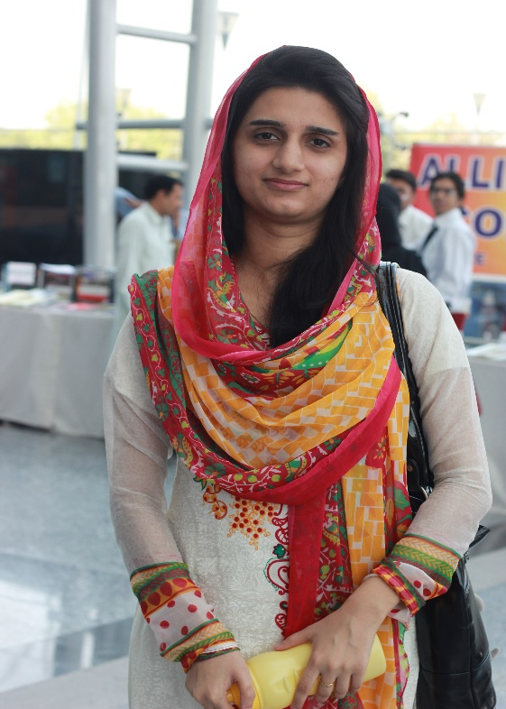
Team Members
Usman Sarwar
I am a developer
Unab zahra I am a content writer
Ali Aslam I am a designer

Slide 3
Value Proposition
Don't let others to decide your future, You are the one responsible for your future,

Slide 4
Problem
Students are not able to opt right career path for their future.
Parents and students find it difficult to select a good institute.
Highly paid career paths are preferred.
Technical careers are more preferred

Slide 5
Solution
A android based application using which user gets familiar with different career paths and institutions out there, which will ultimately help them to choose right the career path.
This app will enable three important tasks….
Let the students choose right career path and education institution.
Let them to support their parents with scholarships.
Break the hypothesis regarding non-technical guys

Slide 6
Major Tasks (To be describe in Concept Video)
Provide list career paths (recommended by the app as well as the interest of the user) to the user. (Complex)
Provide the list of institutions as per field selected by the user (medium)
Provide the scholarship opportunities to the user. (Simple)
Create an impression that the non-technical guys are equally important in an organization as the technical ones. (Medium)

Slide 7
Lets move towards the concept video to make our idea more clearer. Video on YouTube link: https://youtu.be/Hd8bk_iriHc

Slide 8
THANKS FOLKS!!!
Questions and Suggestions are welcome

